Slide 1
Macbeth
By Tommaso Bellucci, Tiziano Talini
Leonardo Nencetti, Parenti Vieri & Filippo Poggiarelli
Class 3DSA Liceo Scientifico Gobetti-Volta
A.S 2018/2019

Slide 2
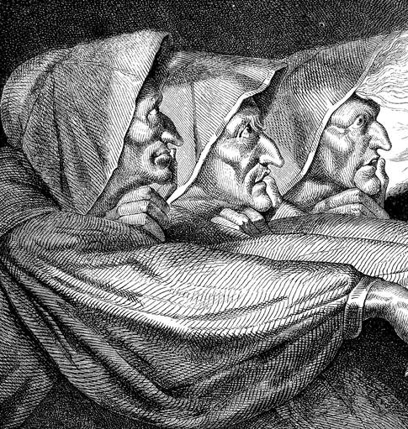
Plot Overview
The play begins with the appearance of three witches and then moves to a military camp, where the Scottish King Duncan hears the news that his generals, Macbeth and Banquo, have defeated two invading armies. Following their battle, Macbeth and Banquo encounter the witches as they cross a moor. The witches prophesy that Macbeth will be made thane of Cawdor and eventually King of Scotland. They also prophesy that Banquo’s sons will become kings, although he will never be king himself.

Slide 3
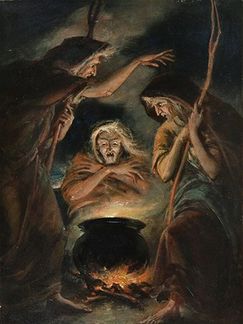
Plot Overview
The witches vanish, and Macbeth and Banquo treat their prophecies skeptically until some of King Duncan’s men come to thank the two generals for their victories and to tell Macbeth that he has been named Thane of Cawdor. The previous thane betrayed Scotland by fighting for the Norwegians and Duncan has condemned him to death. Macbeth is intrigued by the possibility that the witches’ prophecy might be true. He and King Duncan plan to dine together at Inverness, Macbeth’s castle, that night. Macbeth writes to his wife telling her all that has happened.

Slide 4
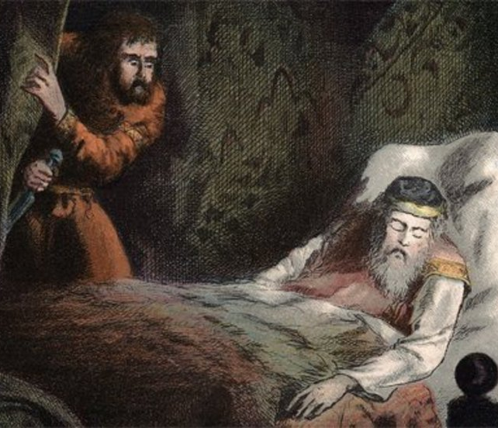
Plot Overview
Lady Macbeth desires the kingship for her husband and wants him to murder Duncan in order to obtain it. When Macbeth arrives at Inverness she persuades him to kill the king that very night. They plan to get Duncan’s two chamberlains drunk so they will black out; the next morning they will blame the murder on them, who will be defenseless, as they will remember nothing.
While Duncan is asleep, Macbeth stabs him; when Duncan’s death is discovered the next morning, Macbeth kills the chamberlains and easily assumes the kingship. Duncan’s sons Malcolm and Donalbain flee to England and Ireland, fearing that whoever killed Duncan desires their demise as well.

Slide 5
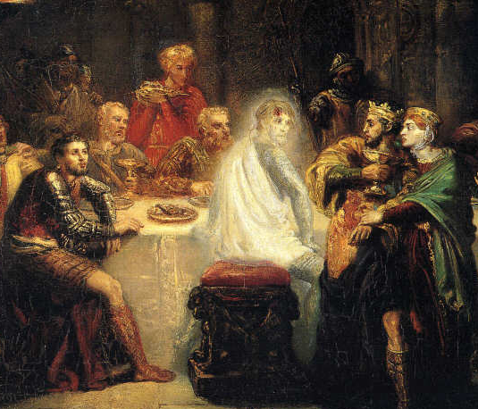
Plot Overview
Fearful of the witches’ prophecy that Banquo’s heirs will seize the throne, Macbeth hires a group of murderers to kill Banquo and his son Fleance. They ambush Banquo on his way to a royal feast, but they fail to kill Fleance, who escapes. Macbeth becomes furious. At the feast that night, Banquo’s ghost visits Macbeth. When he sees the ghost, Macbeth raves fearfully, startling (spaventando) his guests.
Frightened, he goes to visit the witches in their cavern. They foretell him to be careful of Macduff, a Scottish nobleman who opposed Macbeth’s accession to the throne; he (Macbeth) is incapable of being harmed by any man ‘born of woman’ and he will be safe until Birnam Wood comes to Dunsinane Castle. When he learns that Macduff has fled to England to join Malcolm, Macbeth orders that Macduff’s castle be seized and, most cruelly, that Lady Macduff and her children be murdered.

Slide 6
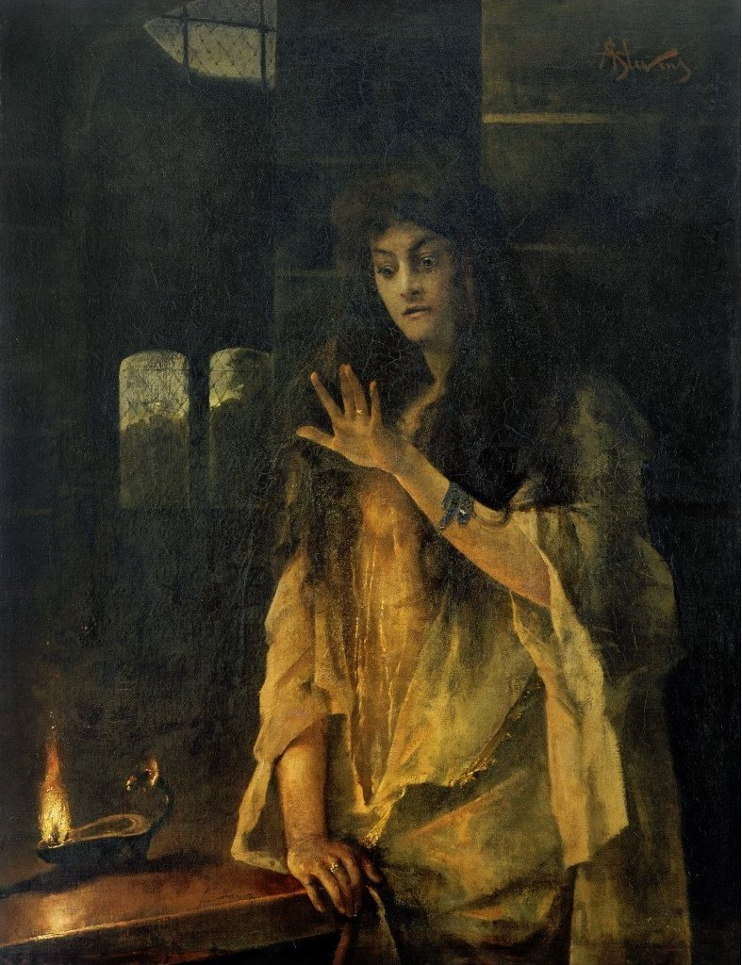
Plot Overview
When news of his family’s execution reaches Macduff in England, he is stricken with grief and vows revenge. Prince Malcolm, Duncan’s son, has succeeded in raising an army in England, and Macduff joins him to challenge Macbeth’s forces. The invasion has the support of the Scottish nobles, who are frightened by Macbeth’s tyrannical behaviour.
Lady Macbeth, meanwhile, sees bloodstains on her hands while sleepwalking. Macbeth receives news that she has killed herself, and sinks into a deep and pessimistic despair. Nevertheless, he awaits the English and fortifies Dunsinane, certain that the witches’ prophecies guarantee his invincibility. He is scared, however, Birnam Wood is coming to Dunsinane, fulfilling half of the witches’ prophecy.

Slide 7
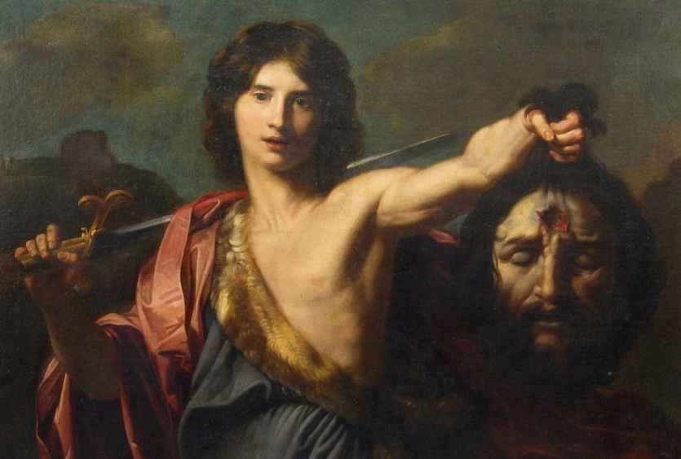
Plot Overview
In the battle, the English forces overwhelm Macbeth’s army and castle. On the battlefield he encounters Macduff, who declares that he was not “of woman born” but was “untimely ripped” from his mother’s womb (birth by cesarean section). Though he realizes that he is doomed, Macbeth continues to fight until Macduff kills him. Malcolm, now the King of Scotland, declares his good intentions for the country and invites all to see him crowned at Scone.

Slide 8
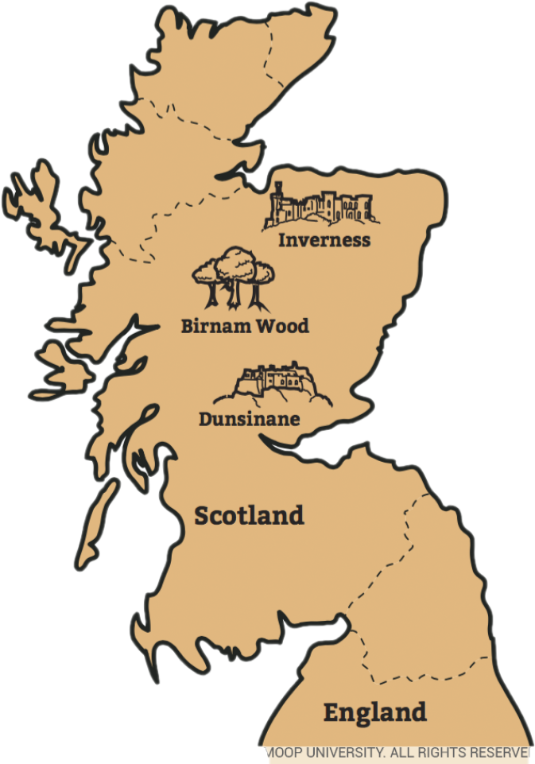
Setting
Macbeth is set during the 11th century in Scotland. At the time the play is set, it was a separate country, although its nearness to England led to many struggles over who would rule the area. Scotland is often dark and damp – the perfect setting for a play about evil deeds done under the cover of darkness.
The play opens during a storm, with the Witches asking if they’ll meet again “in thunder, lightning, or in rain.” The lack of sunlight in the physical setting of the play reflects the secrecy and deception of the title character. Macbeth moves from his castle in Inverness to the royal palace in Dunsinane.
The most important actions take place indoors, at night, suggesting the setting is not terribly important to the action. On the other hand, the references to nature itself being out of order suggest that even the surroundings have been thrown into disorder by Macbeth’s treachery.

Slide 9
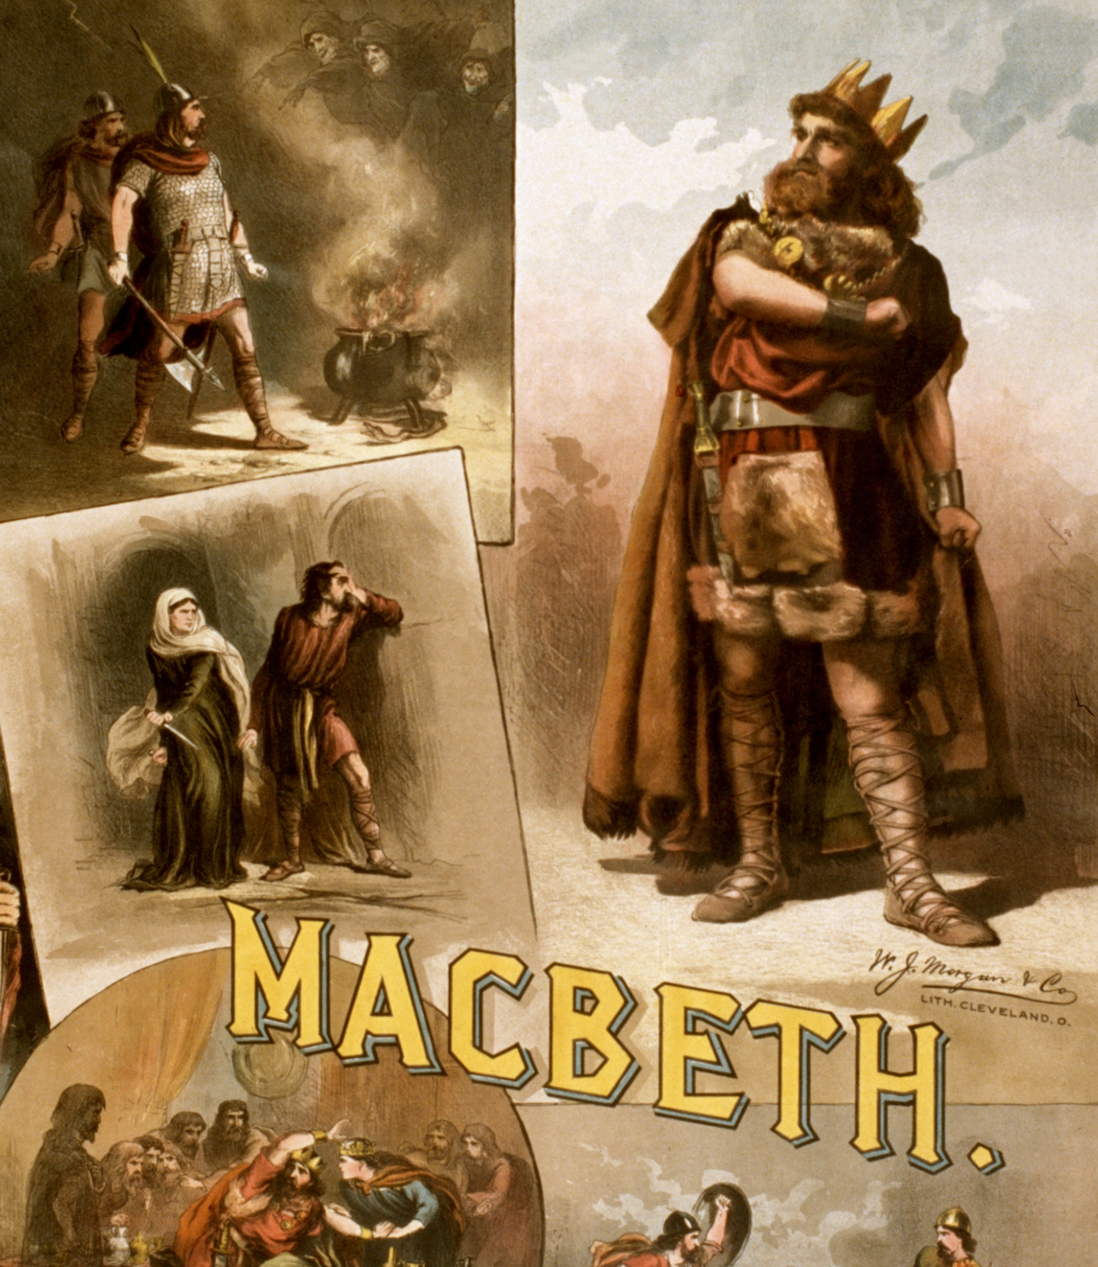
Themes
The Corrupting Power of Unchecked Ambition
The main theme of Macbeth finds its most powerful expression in the two main characters. Macbeth is a brave Scottish general who is not inclined to commit evil deeds, yet he deeply desires power and advancement. Lady Macbeth, on the other hand, pursues her goals with greater determination, yet she is less capable of bearing the consequences of her immoral acts. In each case, ambition is what drives the couple to even more terrible atrocities. The problem, the play suggests, is that once one decides to use violence to further one’s quest for power, it is difficult to stop.

Slide 10
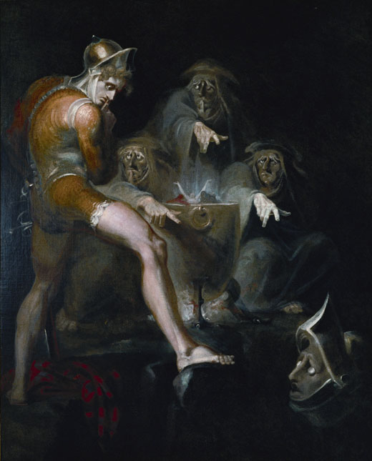
Themes
Ambition
Although he is encouraged by the Witches, Macbeth’s true downfall is his own ambition. Lady Macbeth is as ambitious as her husband, encouraging him to commit murder to achieve their goals. Both Macbeths fail to see how their ambition makes them cross moral lines and will lead to their downfall. Once Macbeth kills Duncan, rather than being able to enjoy the fruits of his ambition, he becomes obsessed with maintaining the power he’s won.
Macbeth’s blind pursuit of power can be contrasted with other ambitious characters in the play like Banquo. Banquo also hears the Witches’ prophesies, and similarly has ambition for his sons. But unlike Macbeth, Banquo’s morality prevents him from pursuing his goal at any cost. At the end of the play, Macbeth has achieved all he wanted, but has nothing. With his wife gone and no hope of producing a prince, Macbeth sees what his unchecked ambition has cost him: the loss of all he holds dear.

Slide 11
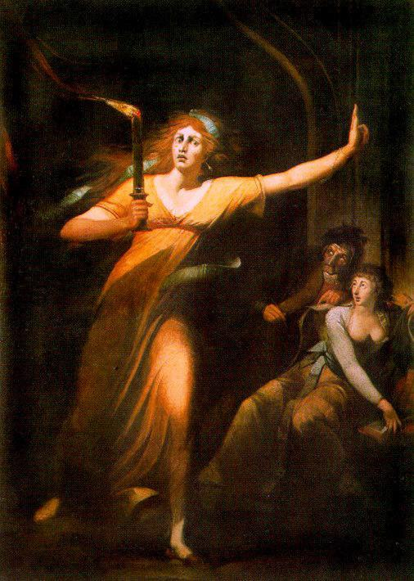
Themes
Guilt
Macbeth’s guilt about murdering his king, Duncan, and ordering the murder of his friend, Banquo, causes him to have guilty hallucinations. Lady Macbeth also hallucinates and eventually goes insane from guilt over her role in Duncan’s death. The fact that both characters suffer torment as a result of their actions suggests neither Macbeth nor his wife is entirely cold-blooded. Although they commit terrible crimes, they know, on some level, that what they’ve done is wrong.
Their guilt prevents them from fully enjoying the power they craved. Lady Macbeth says “What’s done / cannot be undone” in Act Five scene one, but her guilt continues to torment her. While Macbeth’s guilt causes him to commit further murders in an attempt to cover up his initial crimes, Lady Macbeth’s guilt drives her to insanity, and, finally, suicide

Slide 12
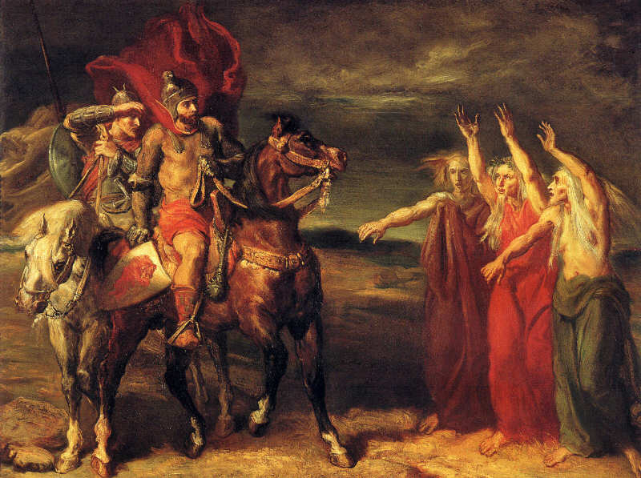
Characters
The three witches are recognised as something supernatural. They have malicious intentions and prophetic powers bur are not active agents. They exist as constant reminders of the potential for evil in the human imagination.Macbeth can be regarded as a tragic hero. At the beginning of the play he is a highly respected soldier. At the end of it he is totally alone because of his ambition. His death is the consequence of his own choices.
The most remarkable quality of his character is his awareness of what is happening to him. What we witness is his gradual de-humanisation. Lady Macbeth shows great strength of will in the first part of the play and is the driving force behind her husband. In the second part of the play she loses her confidence, she’s overcome by madness and dies.

Slide 13
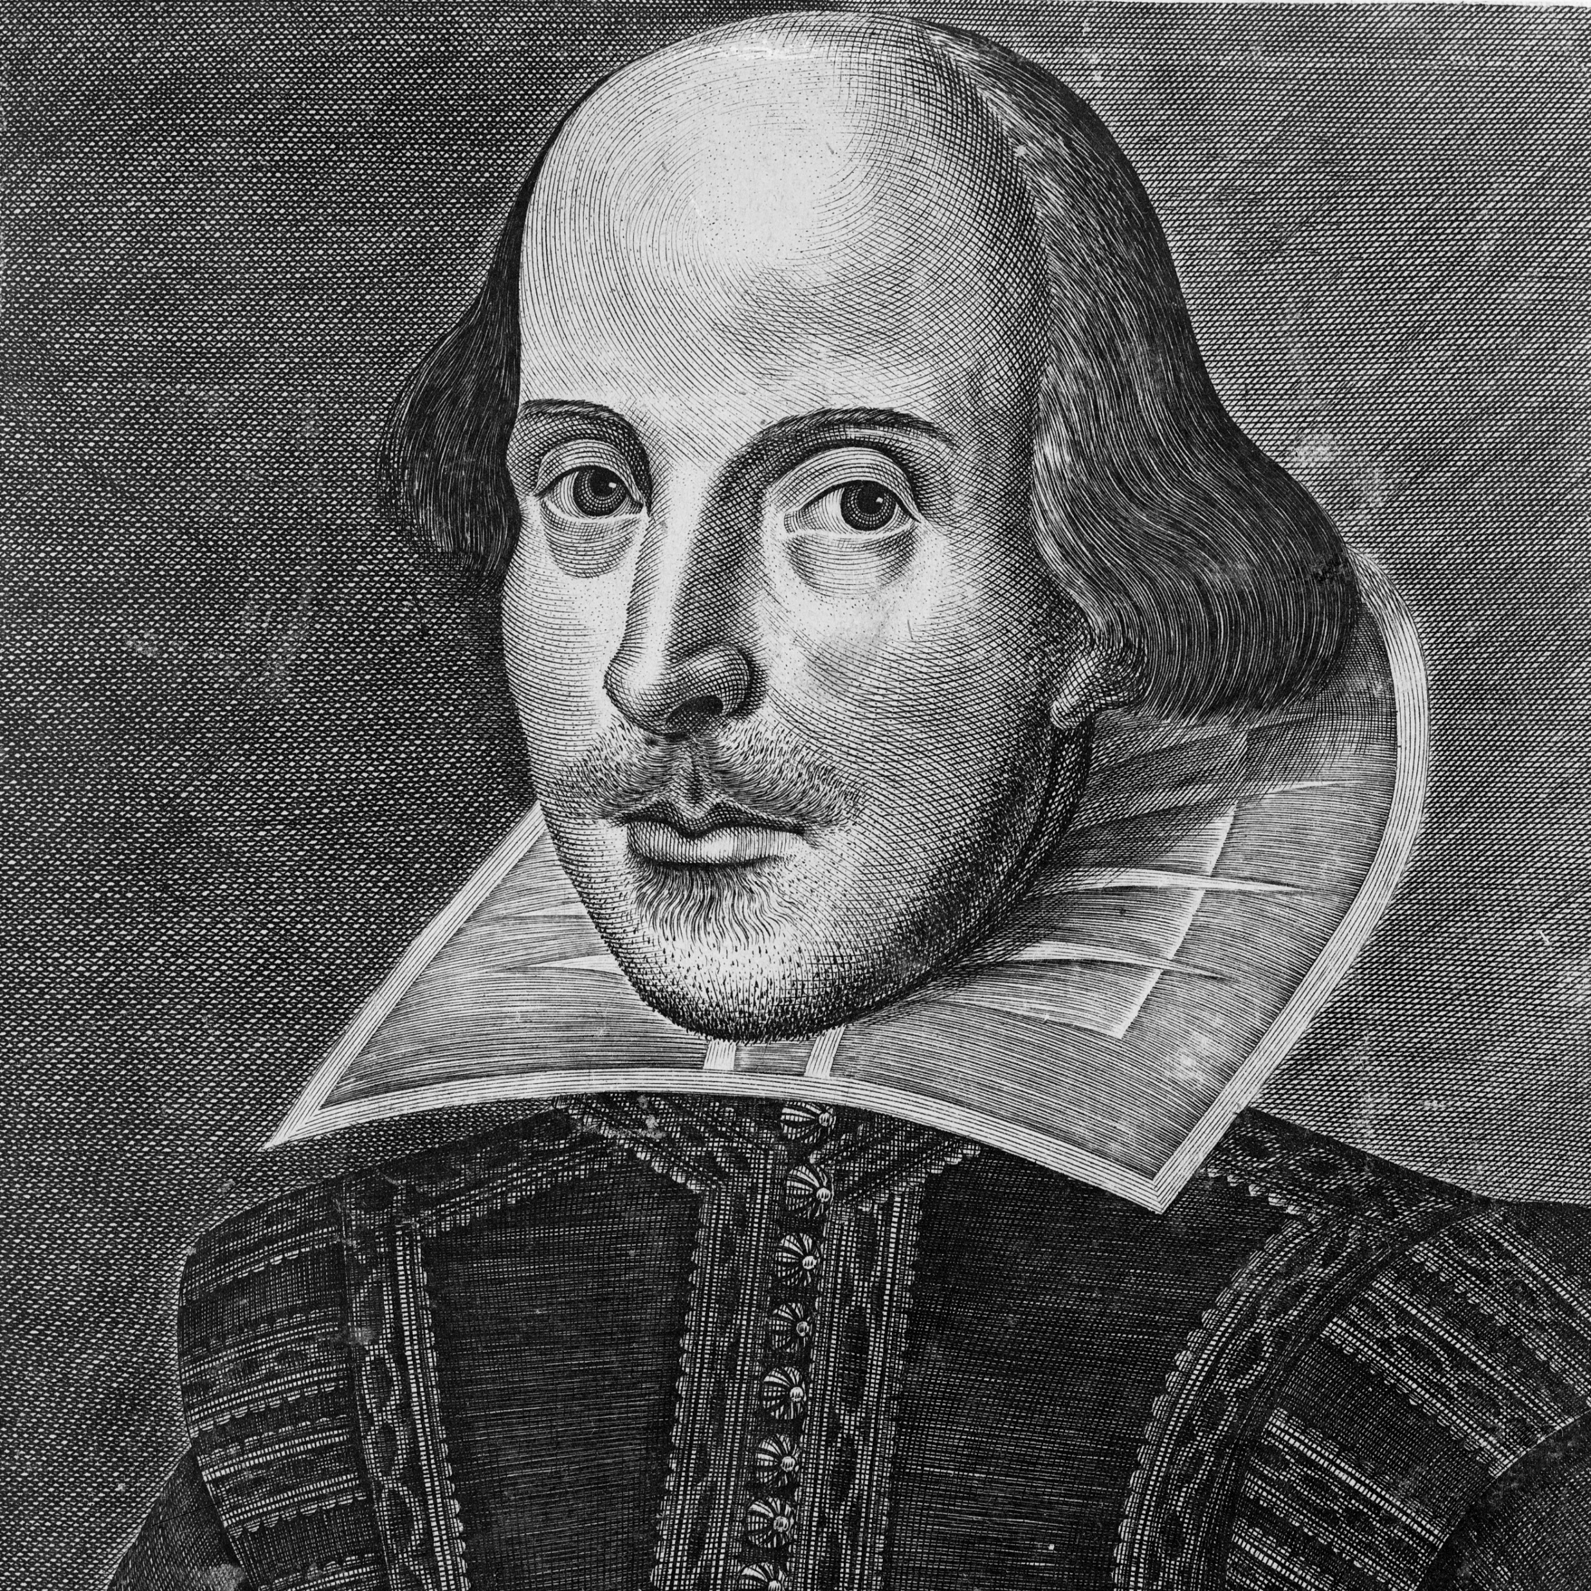
Style
In Macbeth there is striking use of imagery. Duncan is the symbol of the values that should inspire human behaviour. For this reason, his death is connected with exceptional natural events. After the murder the macrocosm of nature mirrors the chaos of the social microcosm. Really dark images linked to the animal world are frequently used by Macbeth. He always expresses his thoughts and emotions in vivid physical terms, like a man who has reached the very edge of humanity.

Slide 14
Sitography
https://www.sparknotes.com/shakespeare/macbeth/summary/
https://it.wikipedia.org/wiki/Macbeth

Slide 15
"So, thanks to all at once and to each one,
Whom we invite to see us crown’d at Scone."
Malcolm (Macbeth, Act V | Scene VIII)

